Slide 1


HomeClaw
Your AI assistant. Your hardware. Your control.
https://github.com/allenpeng0705/HomeClaw

Slide 2
What is HomeClaw?
An AI assistant that runs on your own hardware
One installation = one autonomous agent
Talks over the channels you already use: WebChat, Telegram, Discord, Email, Companion app
Keeps memory (RAG + agent memory) and extends with plugins and skills
Use cloud models (OpenAI, Gemini, DeepSeek…), local models (llama.cpp, GGUF), or both

Slide 3
Why HomeClaw?
Decentralized & private — data can stay at home
Channel-agnostic — same Core, same memory, any channel
Modular — swap LLM, memory, plugins without changing core logic
Extensible — plugins (any language) and skills (workflows)
Mix mode — smart per-request routing: local vs cloud

Slide 4
Architecture
Layer 1 — Clients: Channels (WebChat, Telegram, Discord, Email) + Companion app
Layer 2 — Core:
• Memory (RAG + Markdown agent memory)
• Tools (base for skills)
• Skills & Plugins (registered, filtered per request)
• LLM (local and/or cloud)

Slide 5
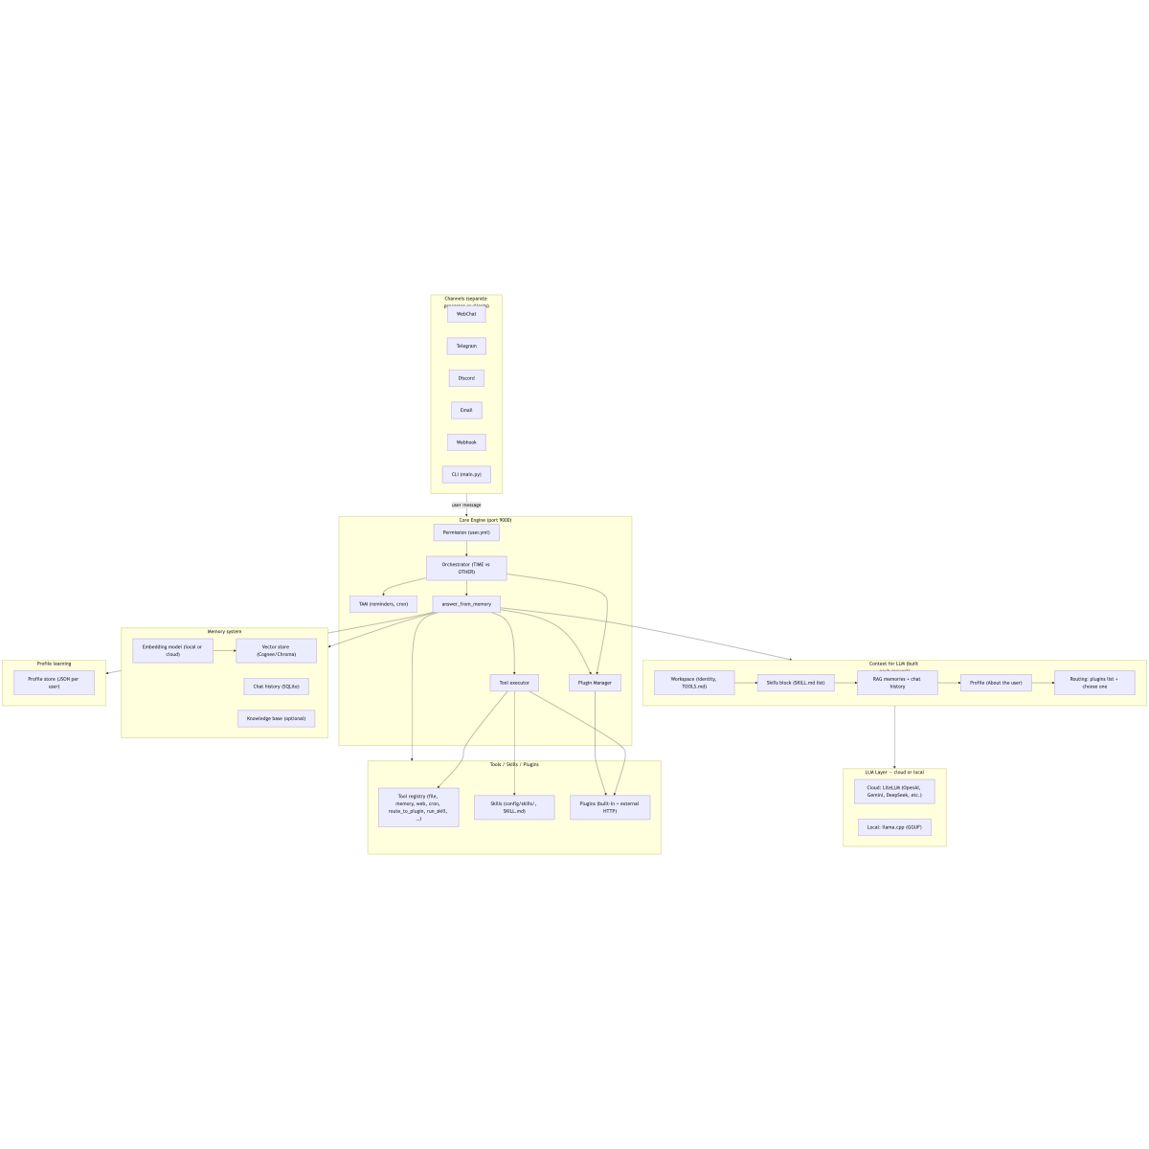
System Overview

Slide 6
Companion app & channels
Companion app — Flutter: Mac, Windows, iPhone, Android
Chat, voice, attachments; Manage Core (edit core.yml, user.yml) from the app
WebChat, CLI, Telegram, Discord, Email — all connect to the same Core
One agent, one memory, one set of tools and plugins

Slide 7
Memory
RAG — vector + relational + optional graph (Cognee default or Chroma)
Agent memory — AGENT_MEMORY.md (long-term), daily memory (short-term)
Per-user context; tools for search and recall

Slide 8
Mix mode: Smart local/cloud routing
Per-request choice: use local or cloud main model
3-layer router (before tools/plugins):
• Layer 1 — Heuristic (keywords, long-input rules)
• Layer 2 — Semantic (embedding similarity)
• Layer 3 — Classifier or Perplexity (small model or main model confidence)
Reports: router decisions and cloud usage via API and usage_report tool

Slide 9
Plugins & skills
Plugins — built-in (Python) and external (any language: Node.js, Go, Java…)
System plugin example: homeclaw-browser (WebChat UI, browser automation)
Skills — OpenClaw-style workflows (SKILL.md); LLM uses tools and run_skill
Multimodal — images, audio, video (local and cloud models)

Slide 10
Get started
Docs: https://allenpeng0705.github.io/HomeClaw/
Repo: https://github.com/allenpeng0705/HomeClaw
Config: config/core.yml (main_llm, memory, tools, hybrid_router…)
Companion app: clients/homeclaw_companion/

Slide 11
Thank you
HomeClaw — for the people.
Contributions welcome. Apache 2.0.
https://github.com/allenpeng0705/HomeClaw

